Slide 1

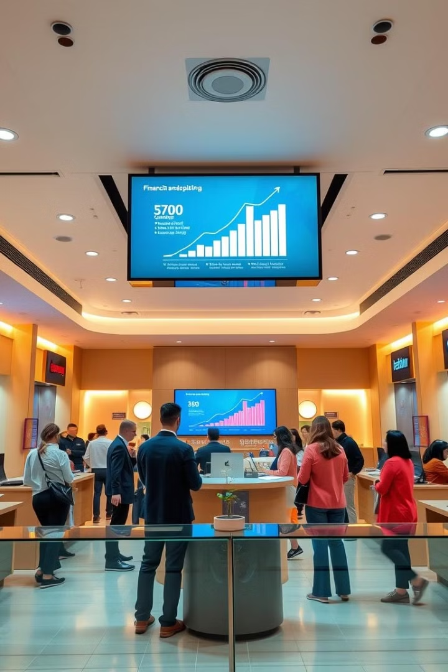

SMDDR
Bank Loan Report: Comprehensive Analysis
This report offers a deep dive into critical loan metrics, trends, and performance indicators. It empowers financial professionals to make data-driven decisions in lending strategies and portfolio management.
Prepared by Mayank Shrivas, this analysis provides invaluable insights for loan officers and data analysts in the banking sector.
by:-
00 Mayank 0 Sasi 0 Deepak
00 Rajesh 0 Dheeraj

Slide 2

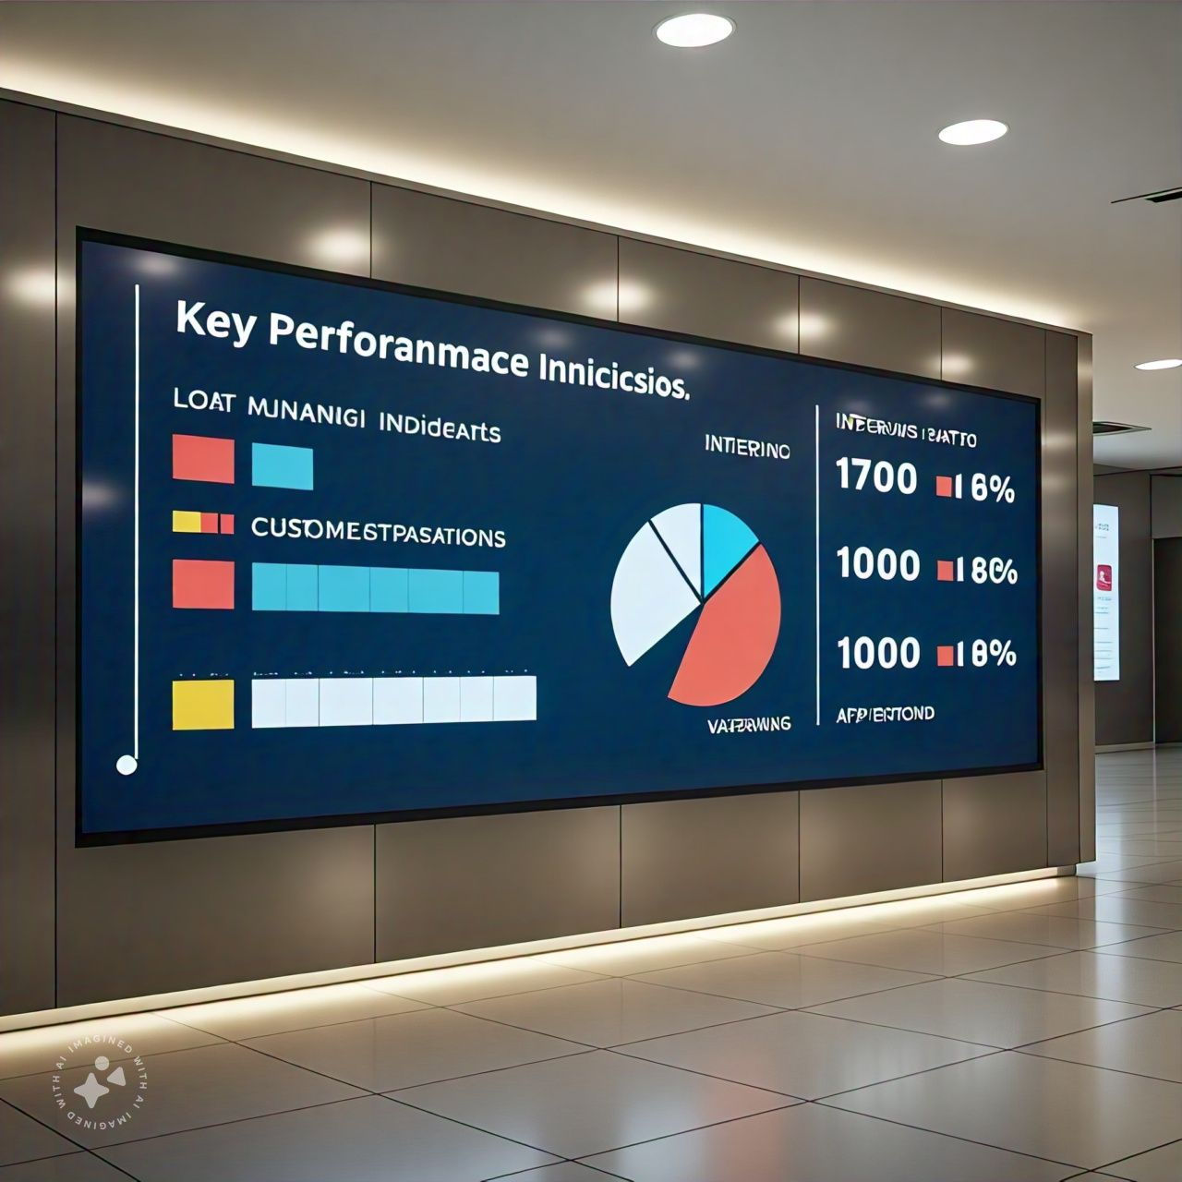




Summary Dashboard KPIs
Total Applications
Funded Amount
Amount Received
Interest Rate
Track loan applications with Month-to-Date (MTD) and Month-over-Month (MoM) changes. Monitor market demand and application processing efficiency.
Monitor disbursed funds, including MTD and MoM changes. Analyze lending volume and capital allocation trends.
Analyze borrower repayments, including MTD and MoM variations. Assess cash flow and repayment behavior patterns.
Calculate average interest rates across loans, with MTD and MoM fluctuations. Evaluate pricing strategies and risk assessment accuracy.

Slide 3
Good Loan vs Bad Loan Analysis
Good Loans
Bad Loans
Encompasses 'Fully Paid' and 'Current' loans. These represent successful lending decisions and reliable borrowers.
Comprises 'Charged Off' loans. These represent potential losses and areas for improvement in lending practices.
Lower application percentage suggests effective risk screening
Higher application percentage indicates strong credit assessment
Minimized funded amount indicates cautious lending approach
Substantial funded amount reflects confidence in borrowers
Reduced received amount highlights potential default risks
Significant received amount demonstrates successful repayments

Slide 4
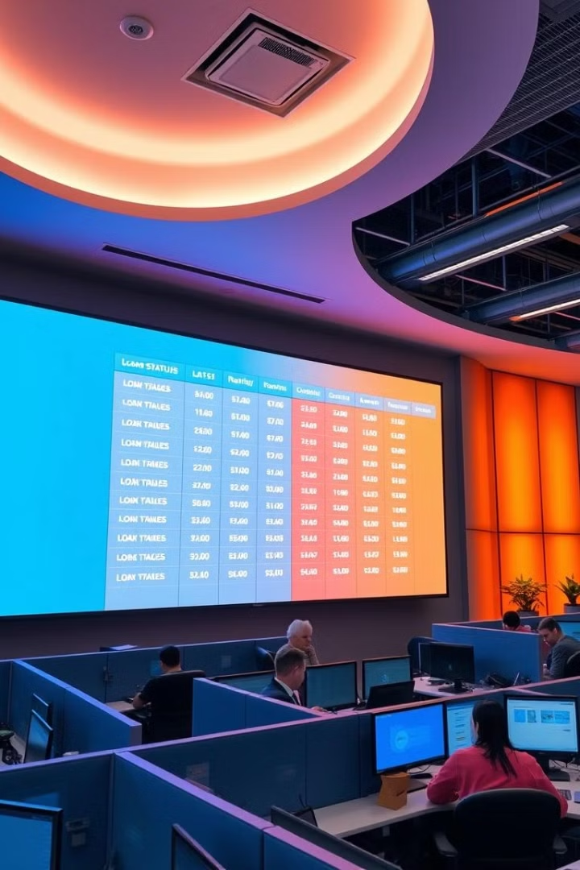
Loan Status Grid View
Loan Status
Total Applications
Funded Amount
Amount Received
Fully Paid
Data
Data
Data
Current
Data
Data
Data
Charged Off
Data
Data
Data

Slide 5
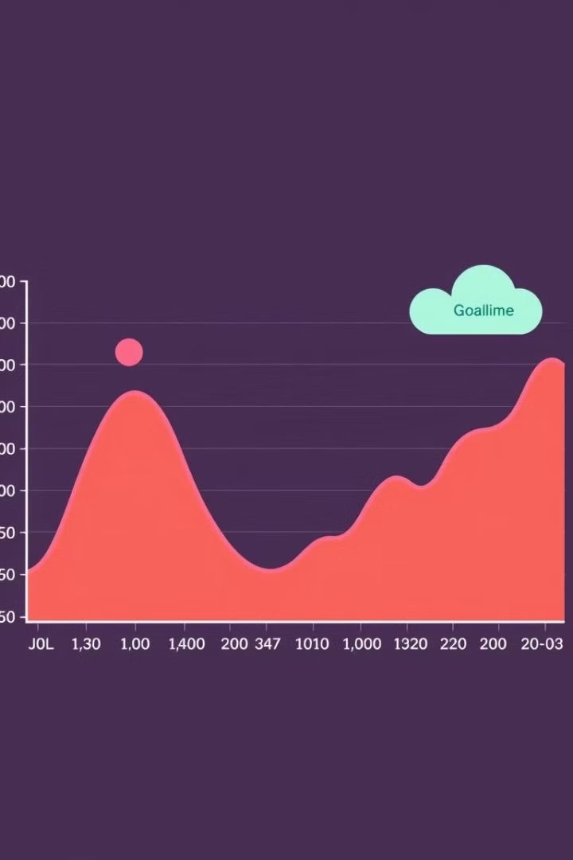
Monthly Trends Analysis
1
Applications
Track monthly changes in total loan applications. Identify seasonal patterns and market demand fluctuations.
2
Funded Amount
Monitor monthly variations in total funded amount. Analyze lending volume trends and capital deployment strategies.
3
Amount Received
Analyze monthly fluctuations in total amount received. Assess repayment behavior and cash flow patterns over time.

Slide 6
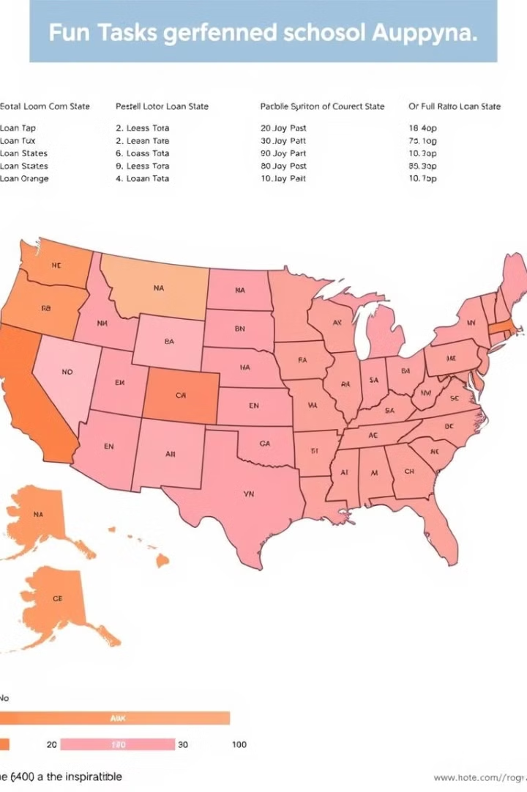
Regional Analysis by State
1
Applications
2
Funded Amount
Visualize total loan applications across different states. Identify high-demand regions and potential growth markets.
Compare total funded amounts by state. Analyze regional lending patterns and capital allocation strategies.
3
Amount Received
Analyze total amount received from each state. Assess regional repayment trends and potential risk areas.

Slide 7
Loan Term and Employee Length Analysis
Loan Term
Employee Length
Impact
Compare 36-month and 60-month loan terms. Analyze preferences, default rates, and profitability for each term.
Examine loan metrics based on borrower's employment duration. Assess correlation between job stability and loan performance.
Evaluate how these factors influence loan applications and performance. Refine lending criteria and risk assessment models.

Slide 8
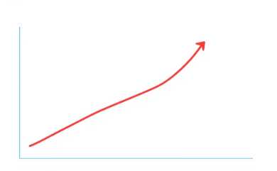
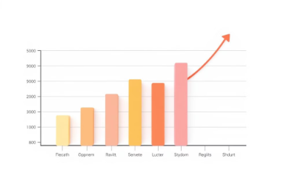

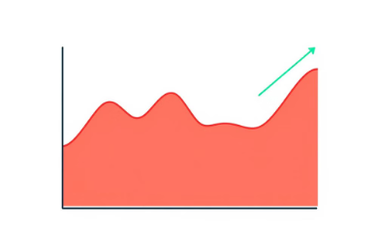
Loan Purpose Breakdown
Debt Consolidation
Home Improvement
Medical Expenses
Other Purposes
Analyze the number of loans issued for debt consolidation purposes. Identify trends and assess the effectiveness of this loan category.
Examine the frequency of loans issued for home improvement projects. Evaluate the performance of this loan category.
Analyze the proportion of loans issued for medical expenses. Understand the impact of this category on overall loan portfolio.
Identify and analyze loans issued for various other purposes. Assess the diversity and performance of these loan categories.

Slide 9
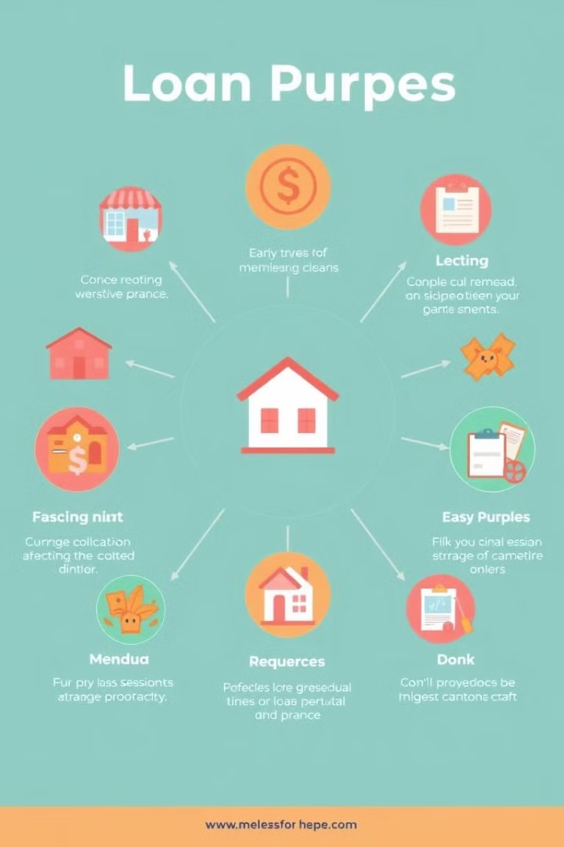
Loan Purpose Breakdown
Home Improvement
Debt Consolidation
Loans for renovations and upgrades. Analyze demand trends and performance metrics for property enhancement loans.
Loans to combine multiple debts. Evaluate risk profiles and success rates of consolidation loans.
Business
Education
Loans for business purposes. Assess performance of small business loans and entrepreneurial funding trends.
Loans for educational expenses. Analyze demand patterns and repayment behavior for student and education loans.

Slide 10




Home Ownership Analysis
Rent
Analyze loan metrics for renters. Assess risk profiles and loan performance for non-homeowners.
Own
Examine loan data for homeowners. Evaluate lending patterns and default rates for property owners.
Mortgage
Evaluate loans for mortgaged properties. Analyze risk levels and loan performance for borrowers with existing mortgages.

Slide 11

Details Dashboard
1
Comprehensive View
2
Key Metrics
Consolidate all essential loan information. Provide a holistic overview of the entire loan portfolio at a glance.
Display vital loan-related data points. Highlight critical KPIs for quick assessment and decision-making support.
3
User-Friendly Interface
Provide easy access to critical insights. Ensure intuitive navigation and data visualization for efficient analysis and reporting.

Slide 12
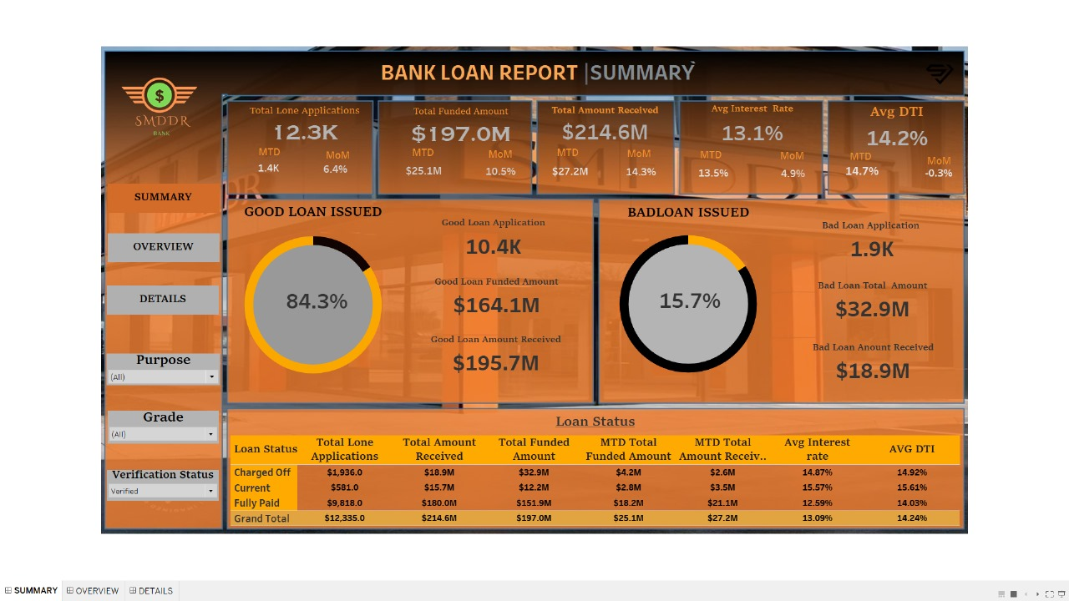
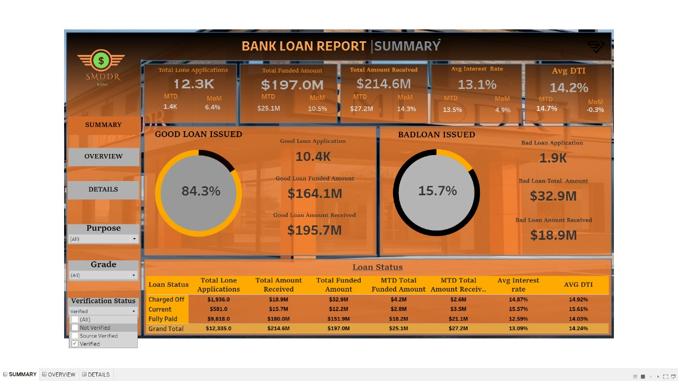
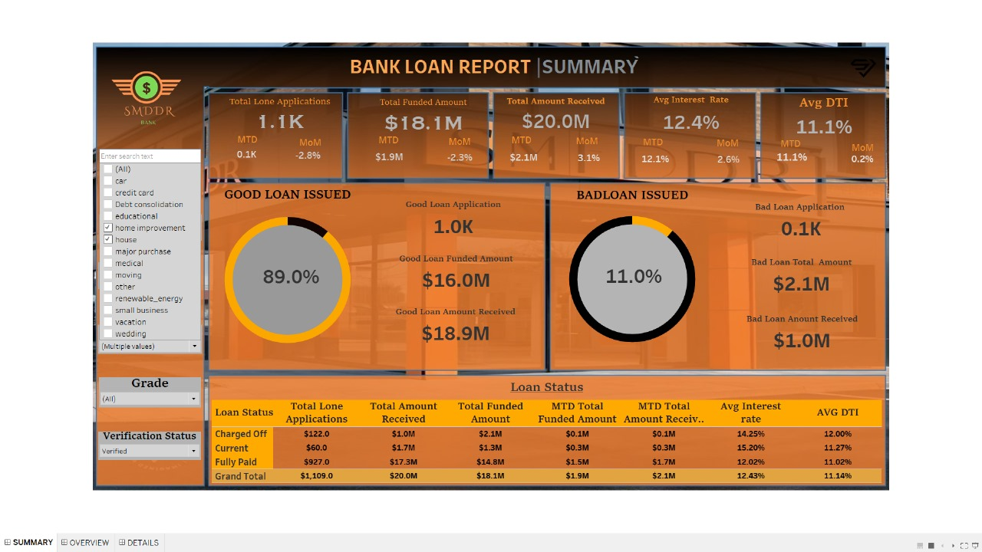
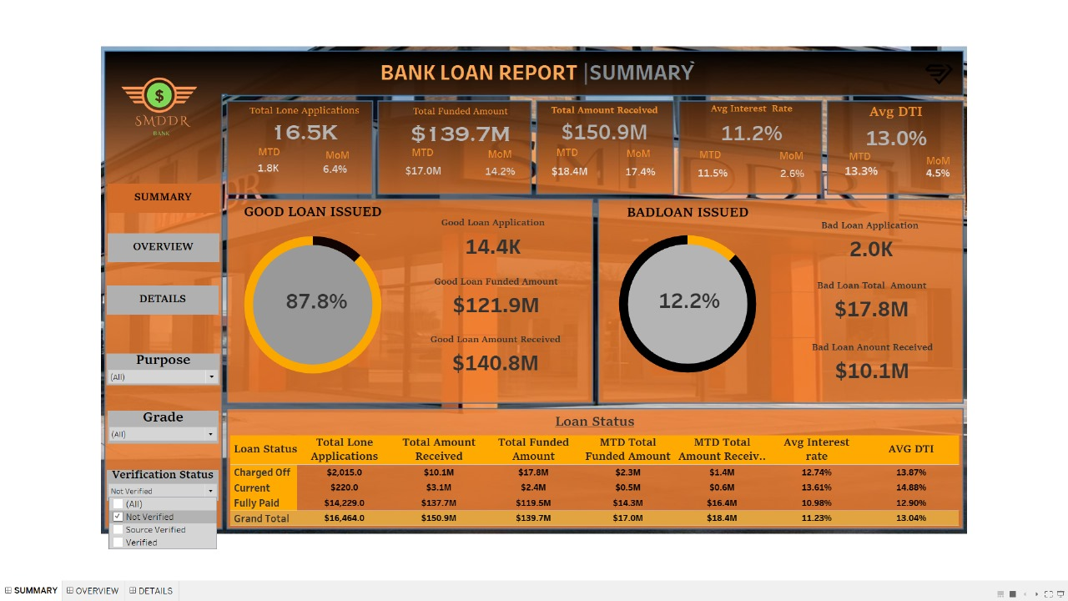

Slide 13
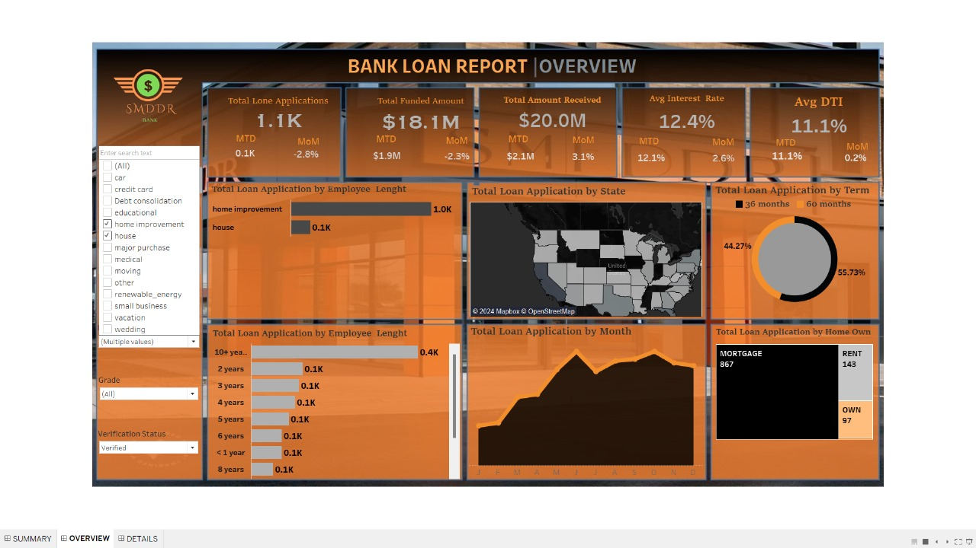
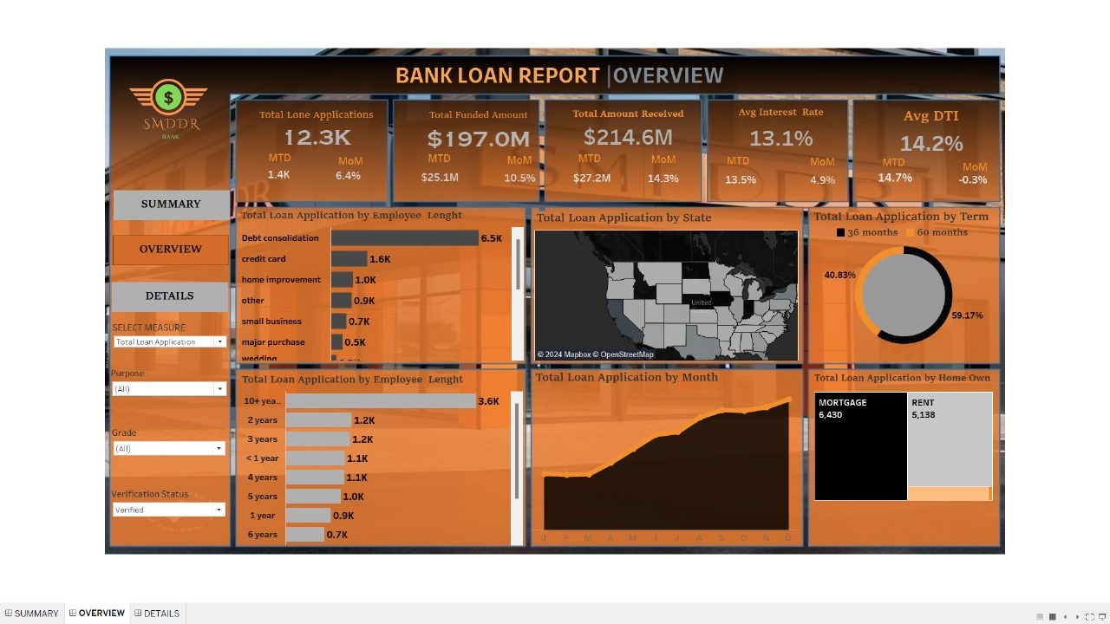
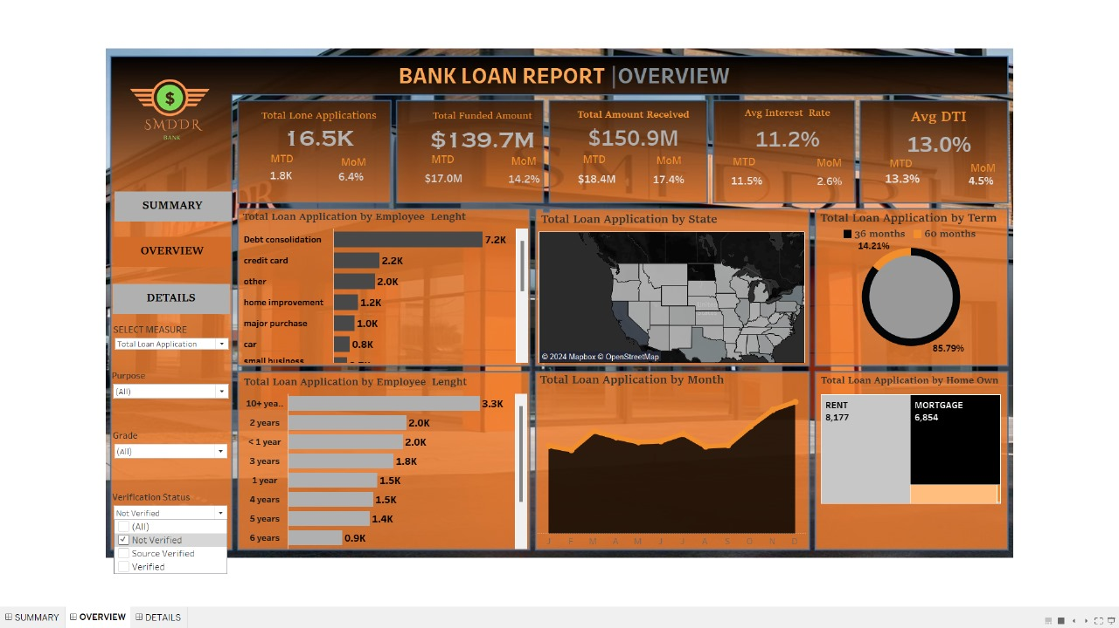

Slide 14
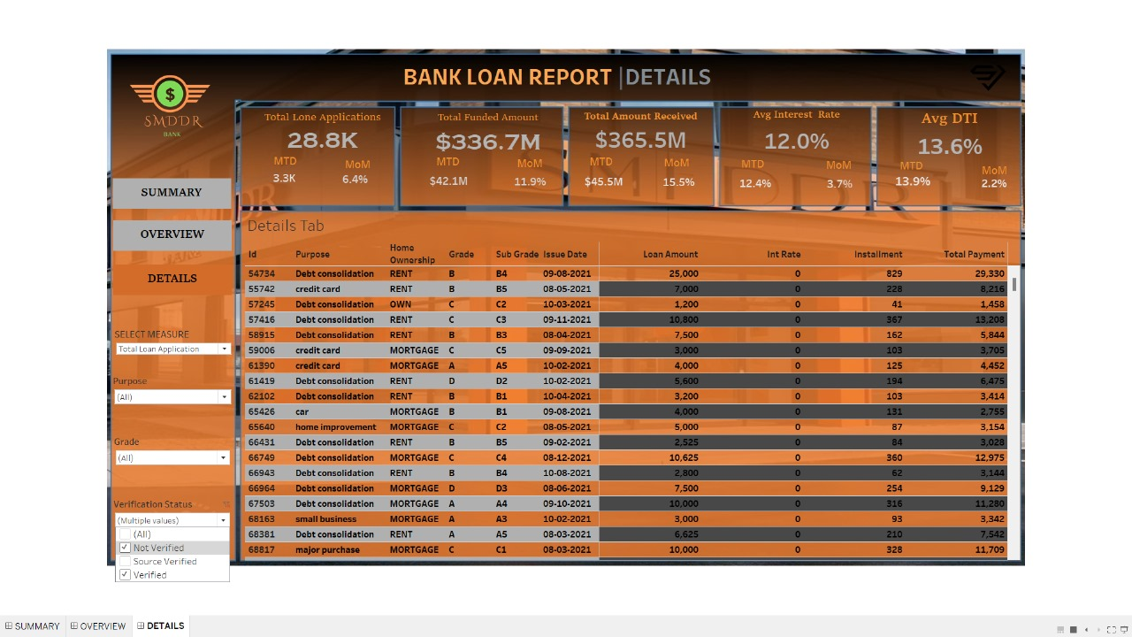
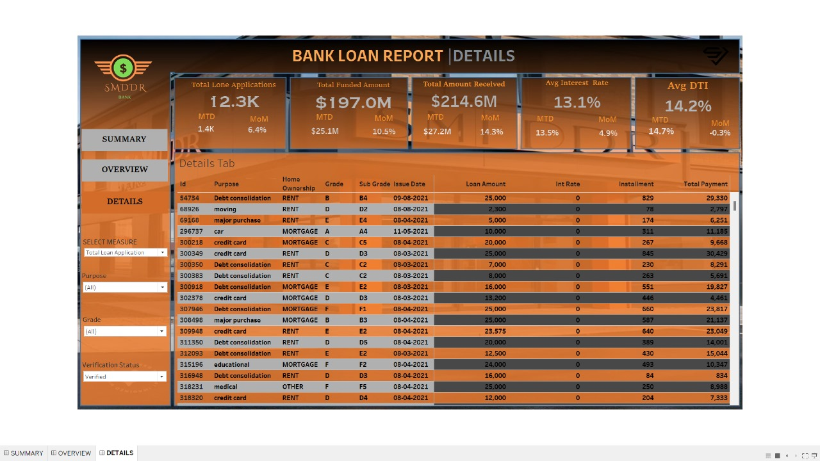

Slide 15
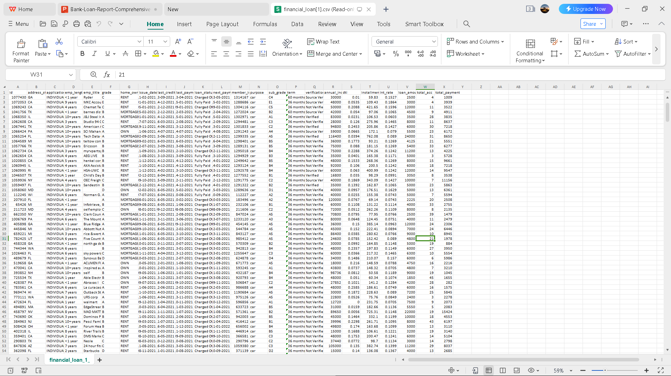
Master Data.xlsv

Slide 16


